Slide 1



Introduction to CI/CD with Python

Slide 2
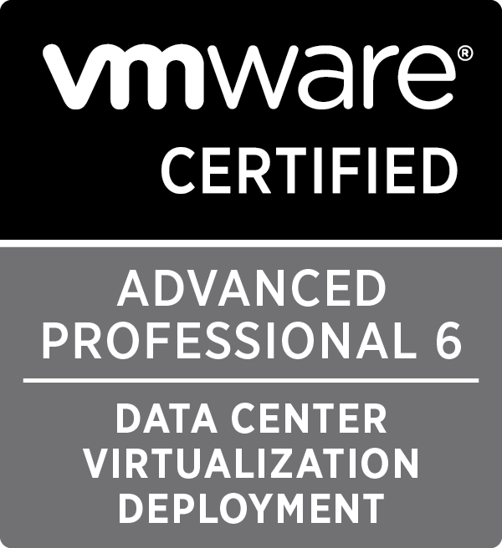
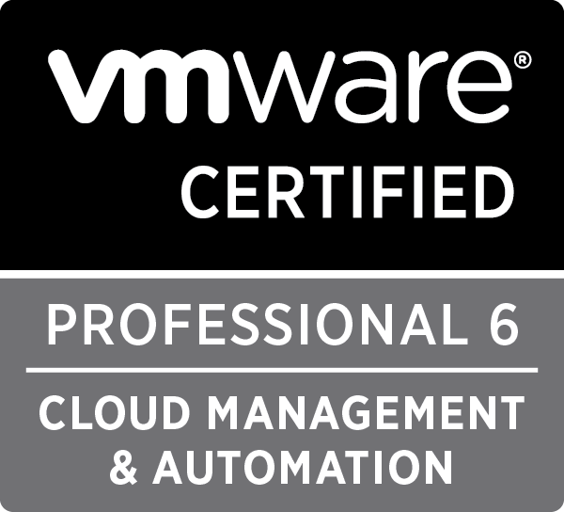
Chris Arceneaux
Solutions Architect at Veeam
carcenea@gmail.com
@chris_arceneaux
Blog: arsano.ninja

Slide 3
Which CI/CD platform is right for you?

Slide 4
Useful Links
GitLab CI
GitLab CI Sample Code
Test and deploy a Python application with GitLab CI/CD
Using GitLab CI/CD with a GitHub repository
GitLab CI Documentation
Travis CI
Travis CI Sample Code
Travis CI DPL – can be used with GitLab CI as well!
Travis CI Documentation
Slides available at: https://arsano.ninja

